Slide 1
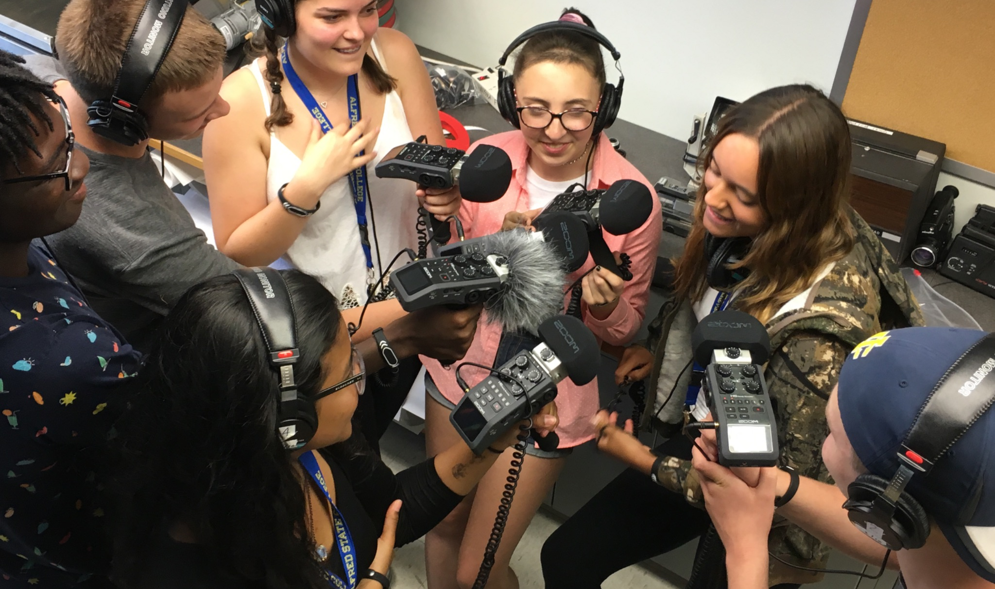
NEW YORK STATE
SUMMER SCHOOL FOR MEDIA ARTS
PORTFOLIO
APPLICATION
GUIDE

Slide 2
CREATE YOUR SLIDESHOW PORTFOLIO
After you’ve downloaded this presentation, open it in Google Slides (File Open Upload)
In this slideshow, find the discipline(s) within Media Arts that you are applying for.
Respond to the Artistic Statement in the discipline(s) you are applying for. Your response should fit the text box provided. Please edit for spelling and grammar.
Insert artwork photo or links to your work. Make the artwork image as large as possible without touching the slide edges. Include the artwork’s title, dimensions, and medium.
Change the title of the presentation in the upper left corner of your screen using the format Lastname_Portfolio.
Check your sharing settings. Change to “anyone on the internet with this link can view.”
Make a Google folder titled as LastName_FirstName_SOMA. Check the sharing settings on your Google folder. Change to “anyone on the internet with this link can view.” Place your slide show into the folder.
Share folder with nysssa@nysed.gov

Slide 3
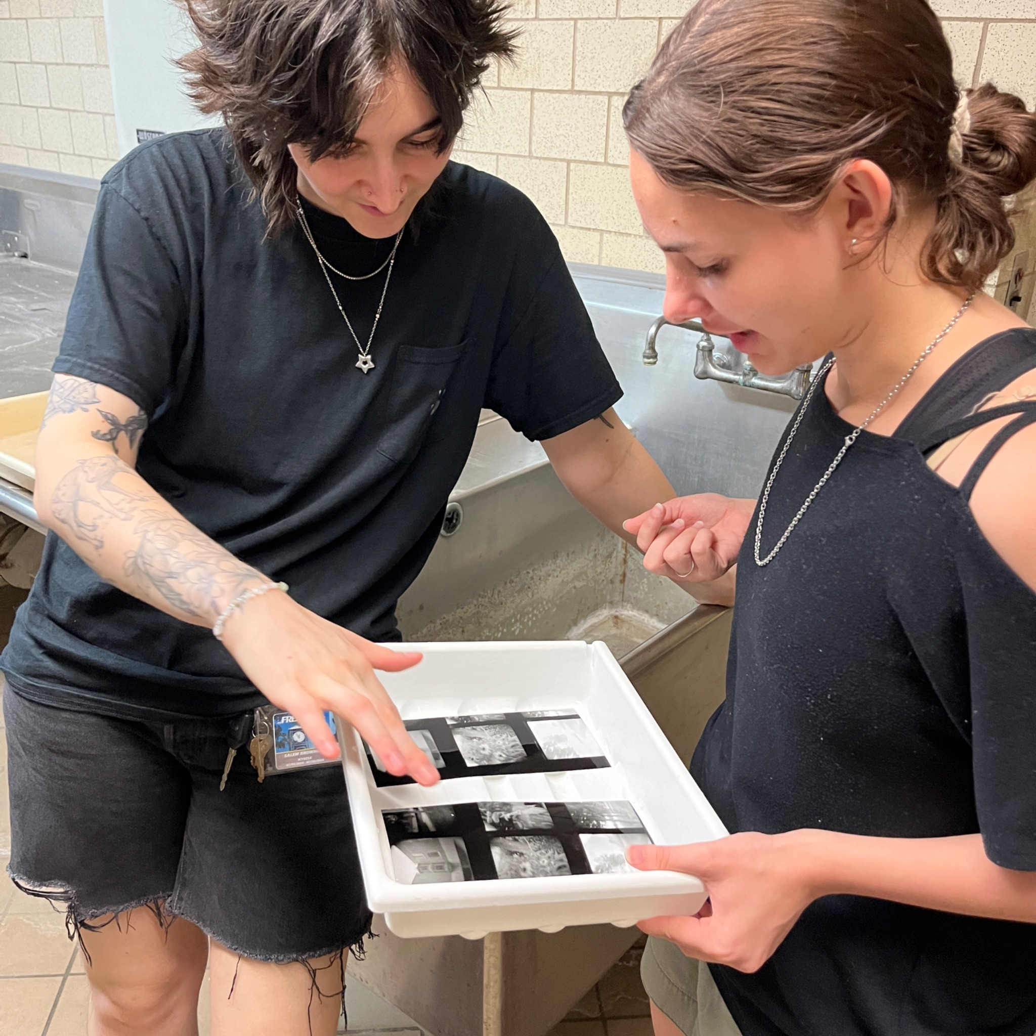
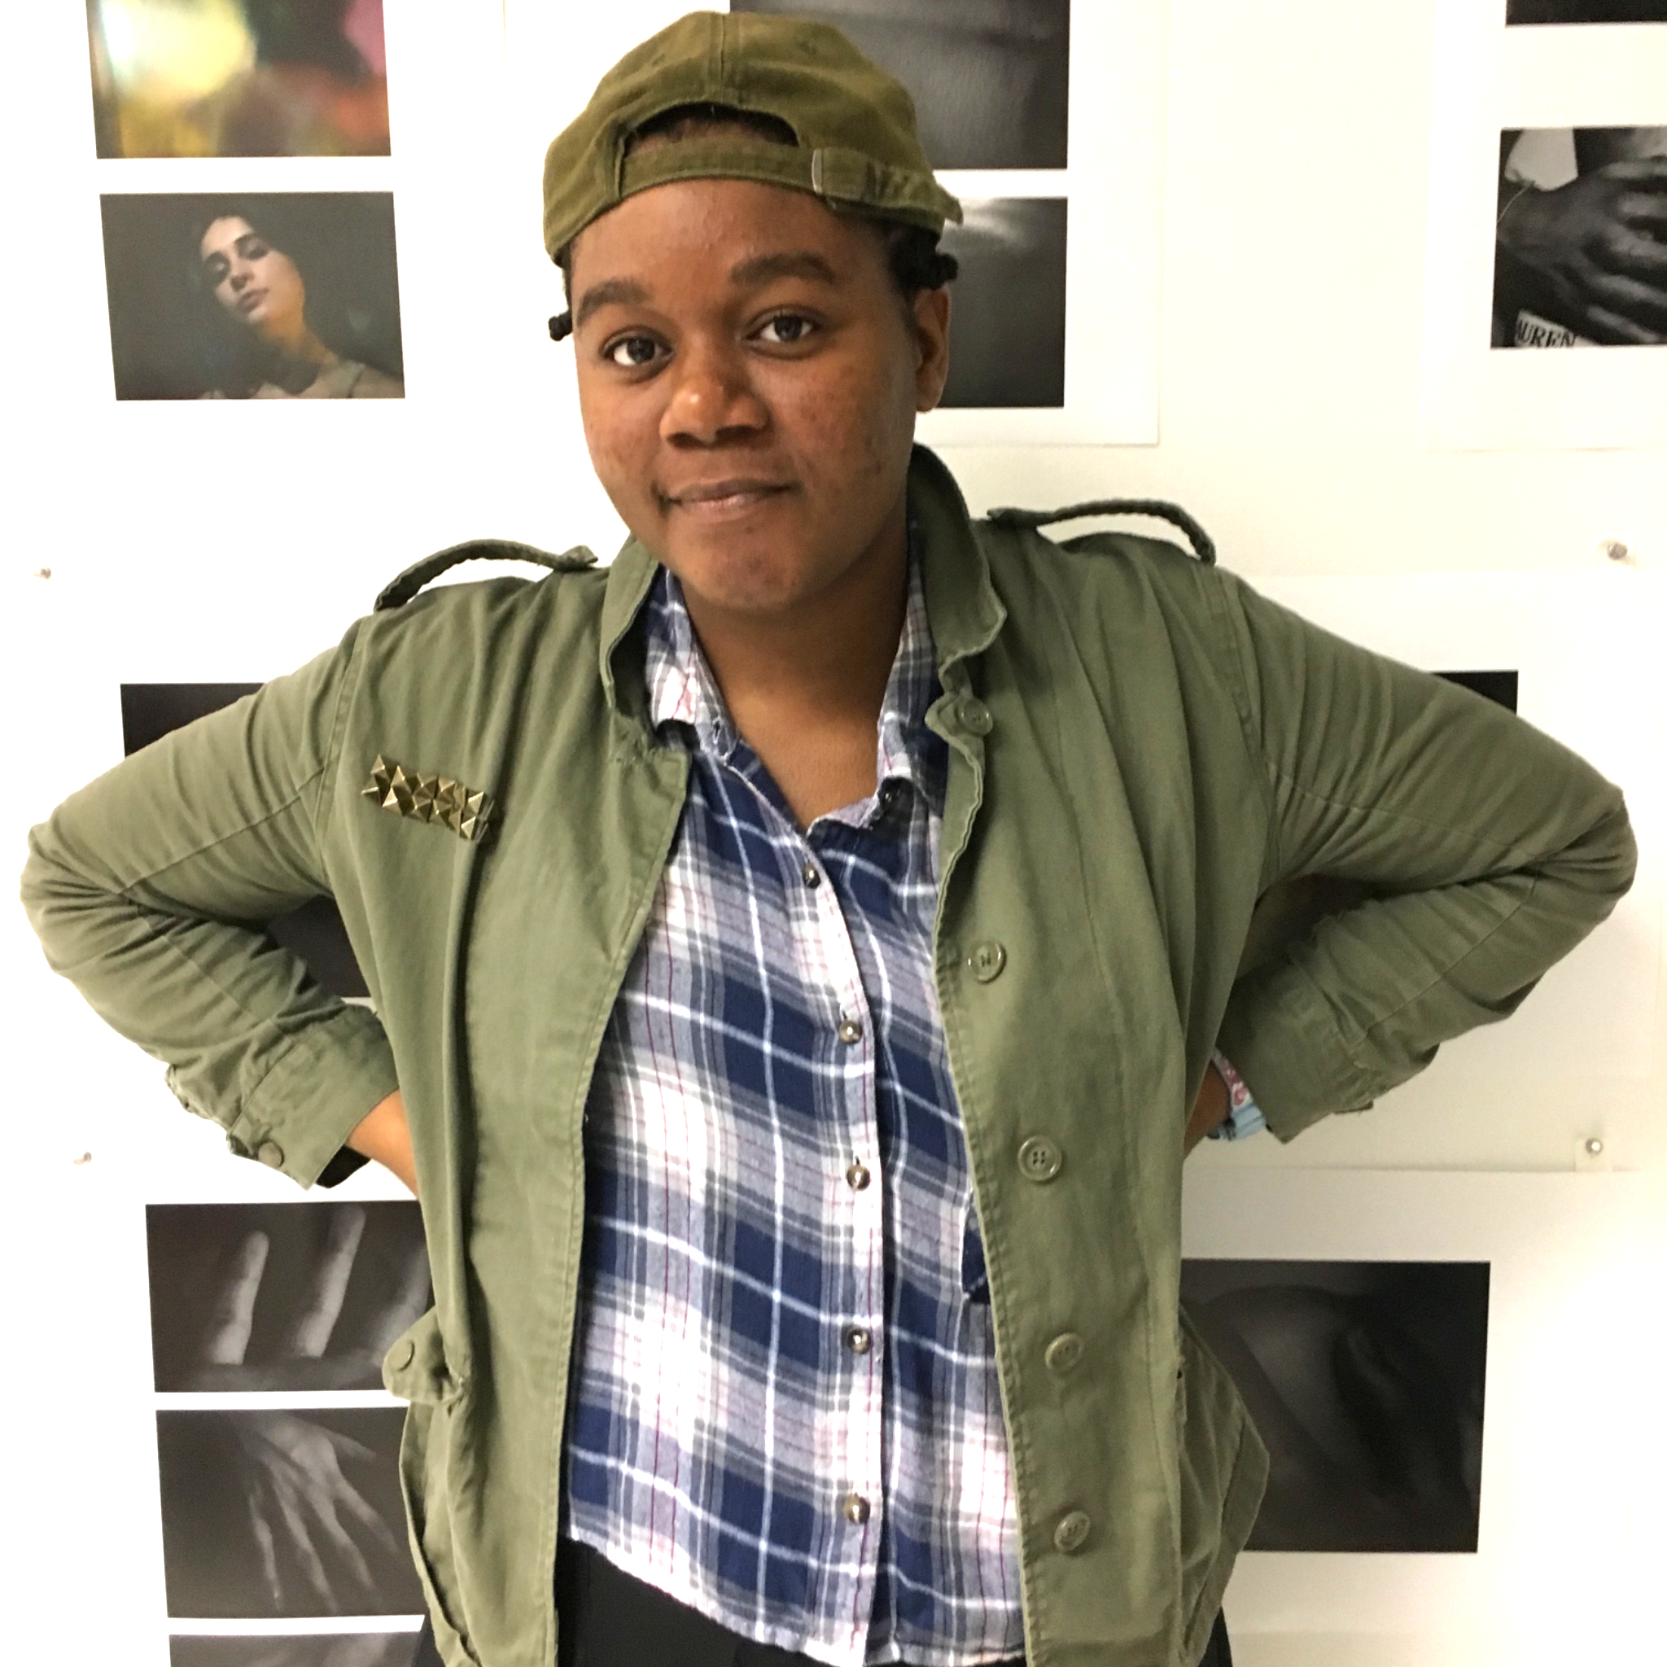
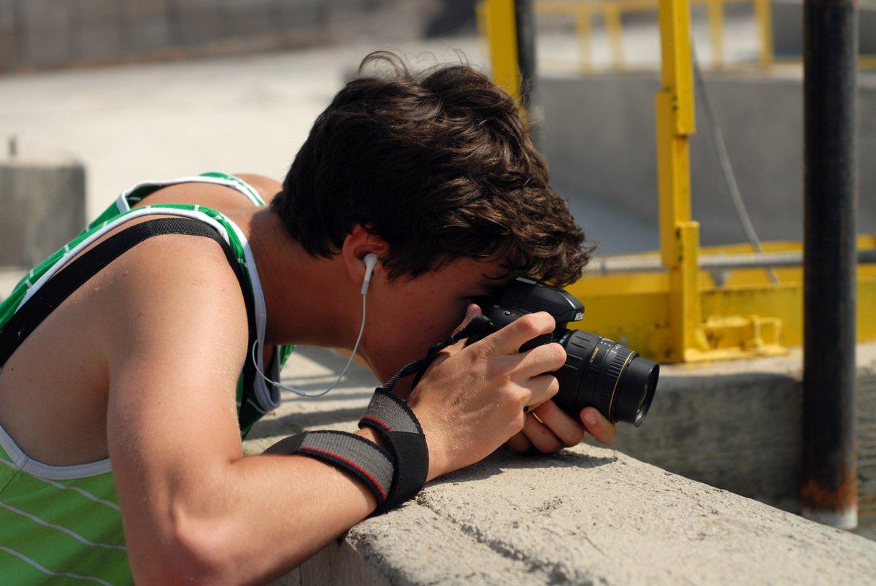
PHOTOGRAPHY
Submit 6 - 8 of your strongest images and write about each image in your Artist Statement - talk about how the work relates to your artistic vision and how you want to use the images as a building block to future work.
Include any relevant technical information such as medium, size, date, title, etc.
Students learn to use digital & analog cameras, darkroom and digital printing techniques, studio lighting, Adobe photo editing software, and experimental photographic processes.

Slide 4
Photography Application Artist Statement
Look at the photographs in your portfolio and write about how they relate to your artistic vision. Explain how you want to use the images as a building block for your future work. Include technical information and titles. (250 words max.)
[Type here]

Slide 5
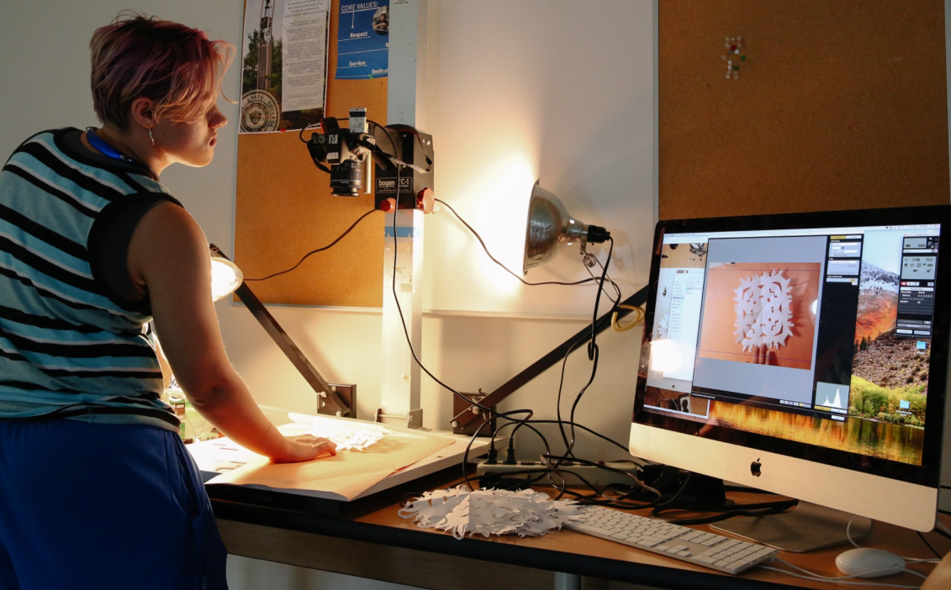
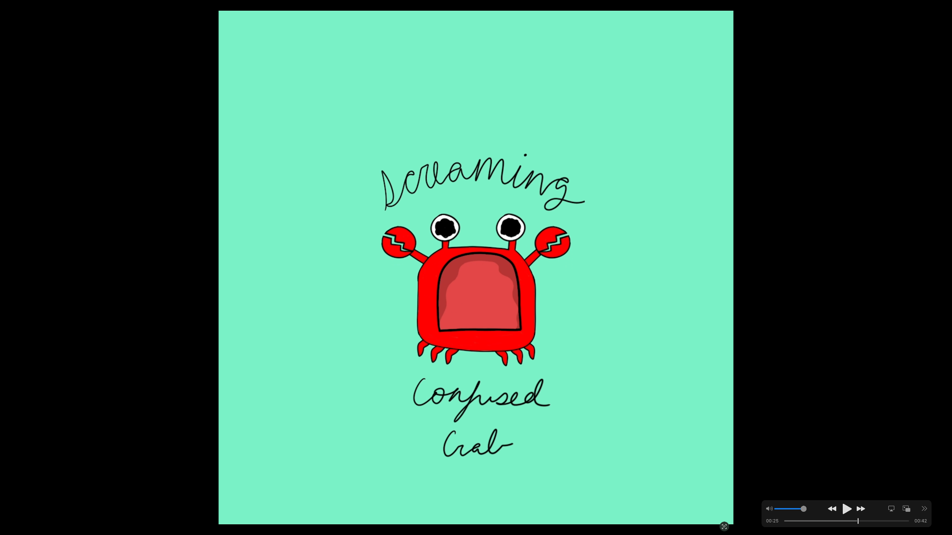
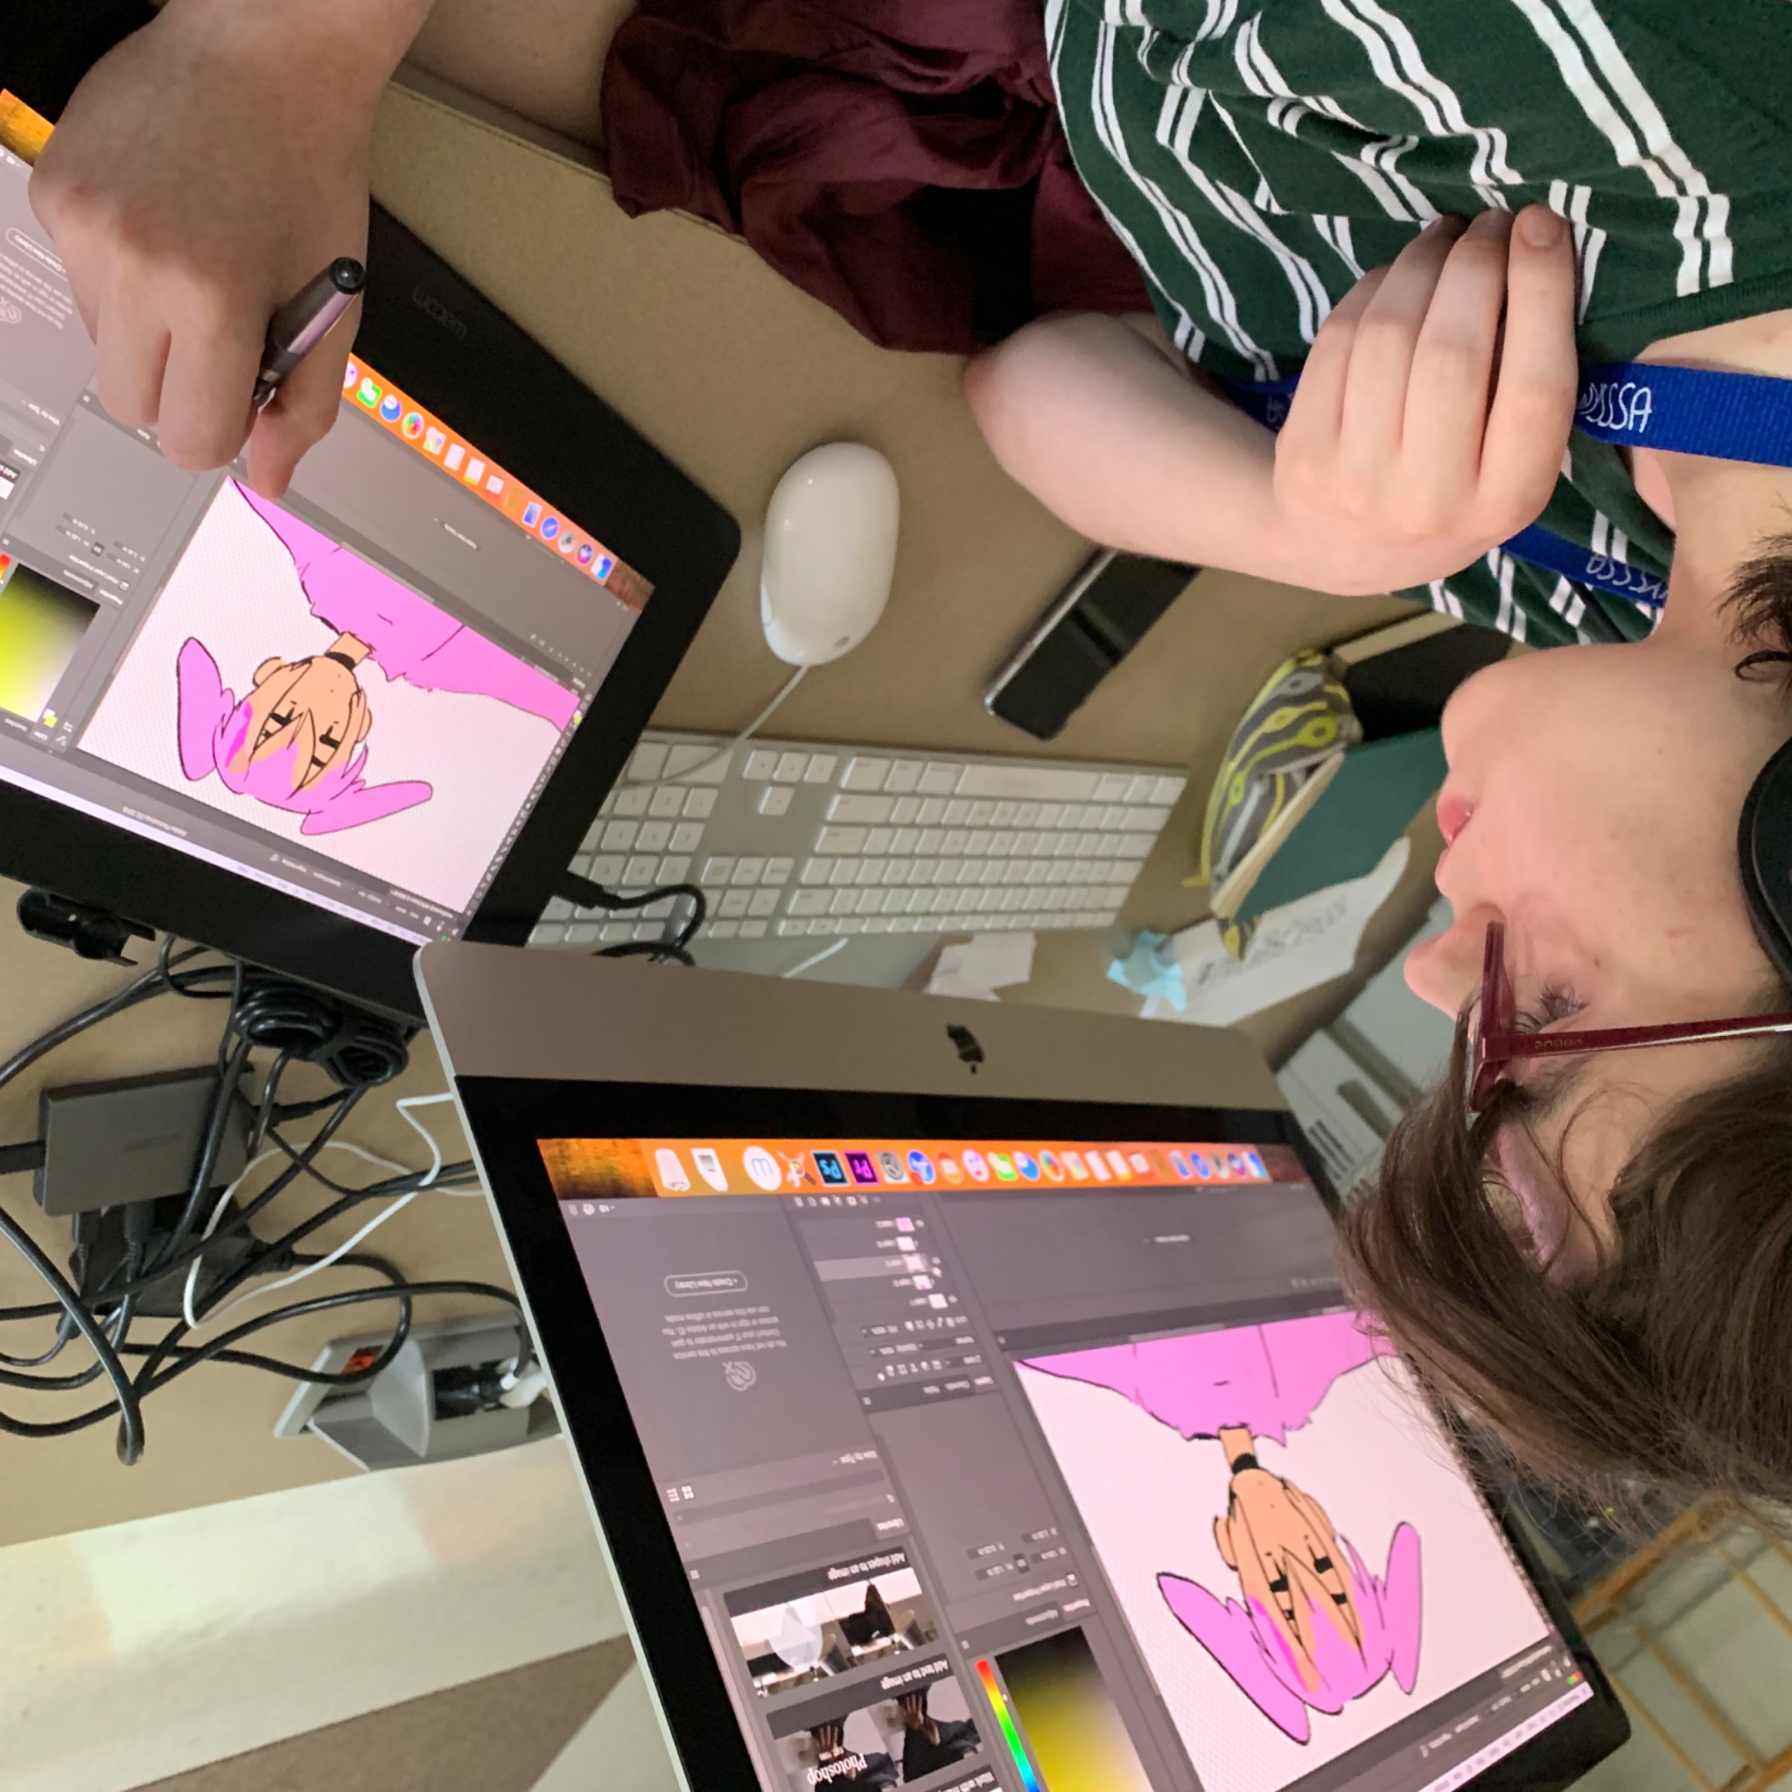
ANIMATION
Submit up to 3 animation files or 4 - 6 drawings, collages, or paintings – in your portfolio that reflect your artistic vision and write about them in your Artist Statement. You may also include storyboards or written scripts. Submit your files using Google Drive or provide links to the work on Youtube or Vimeo in your application.
Both experienced and beginning students learn the art of animated motion, sound design, and storytelling in digital 2D and 3D mediums. We learn to work with stop- motion camera rigs, iMacs, drawing with Cintiq tablets, and production and editing software in Adobe Suite.

Slide 6
Animation Application Artist Statement
Write about the work in your portfolio and talk about your interest in animation as a creative and technical process that you wish to explore at NYSSSA (250 words max).
[Type here]

Slide 7
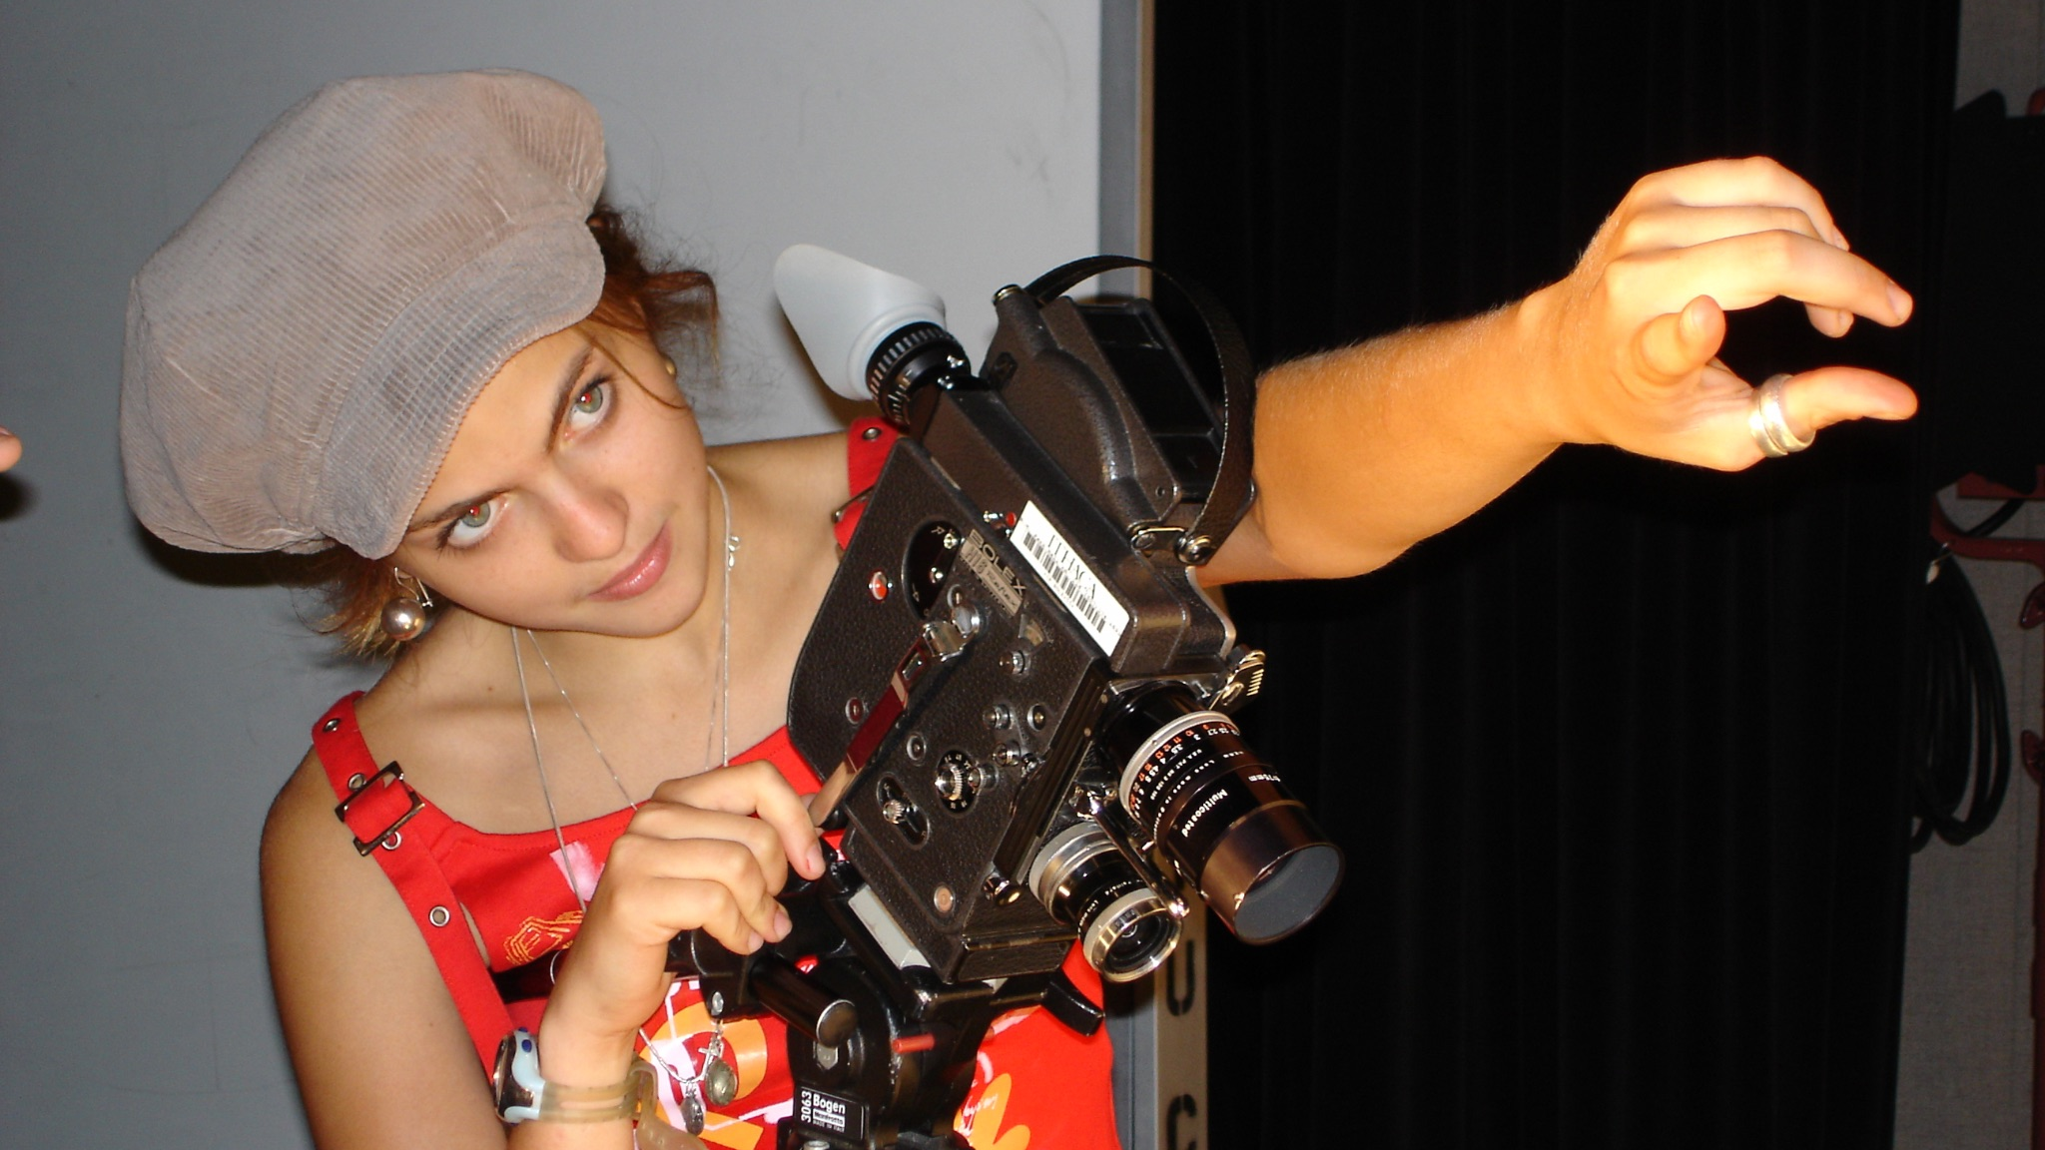
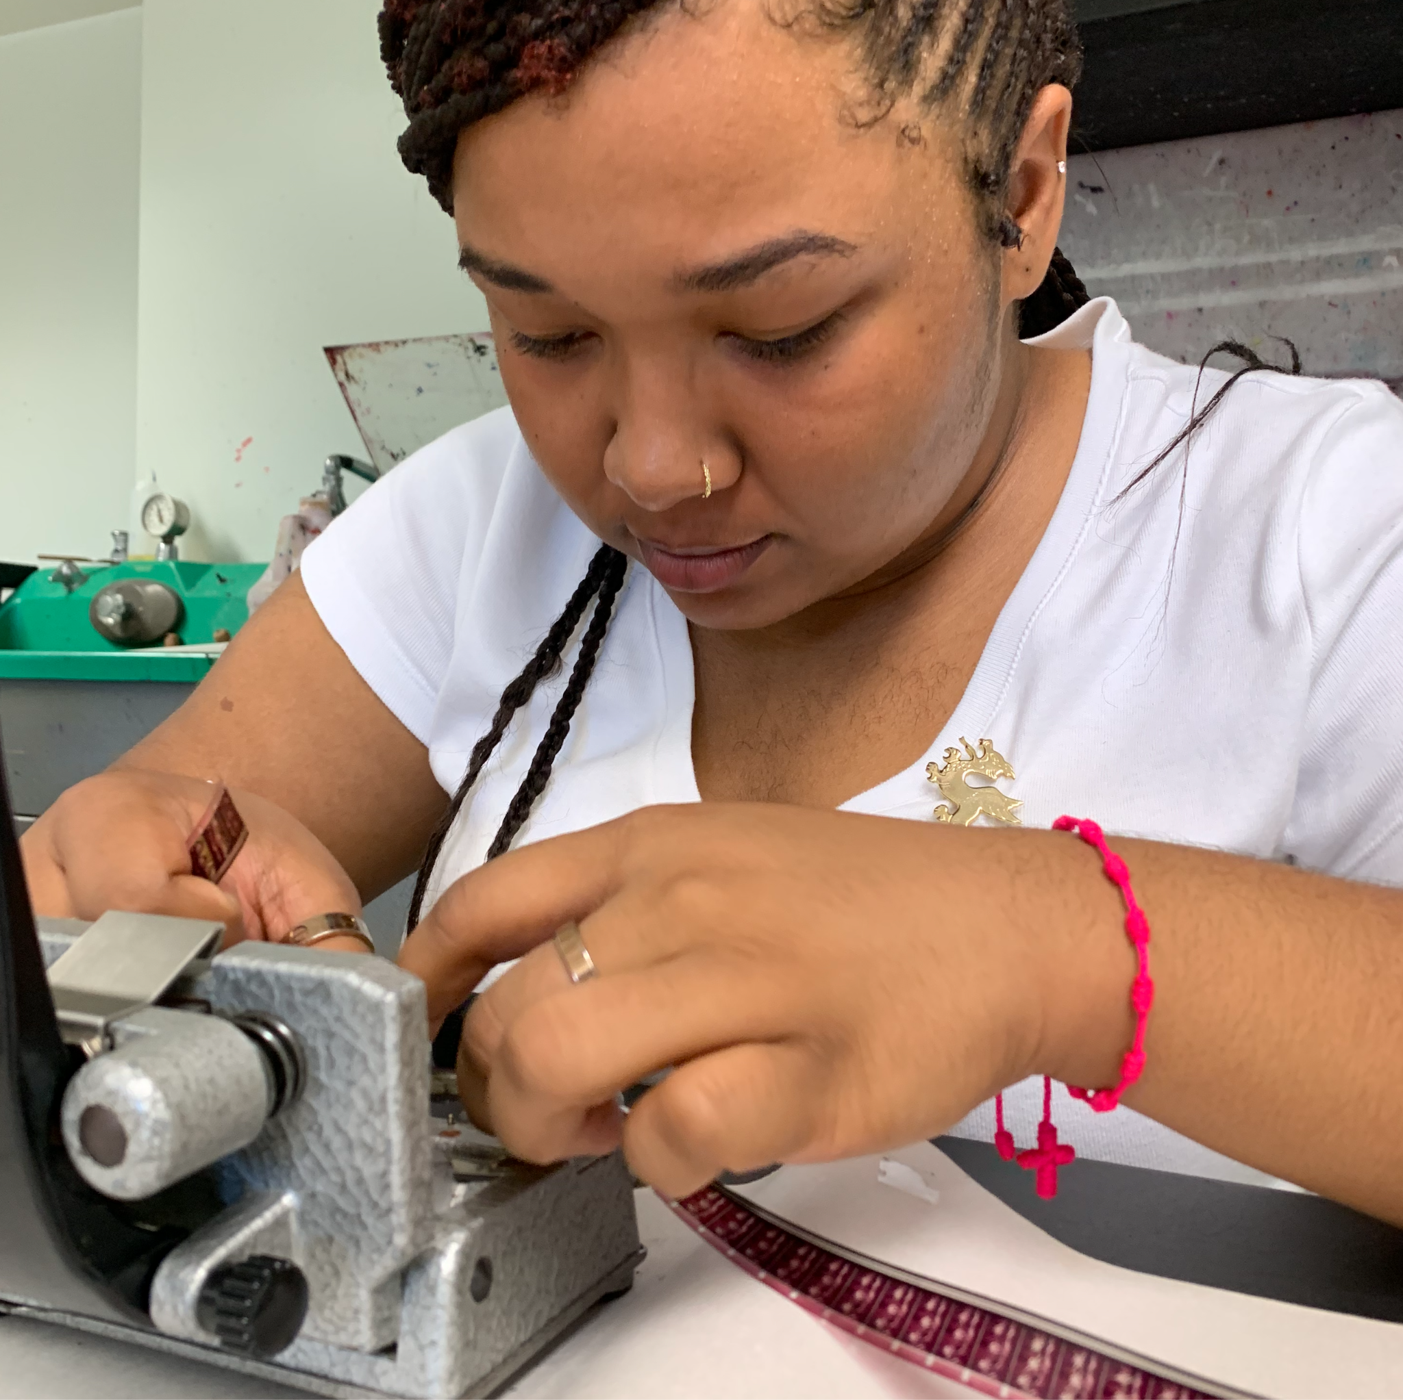
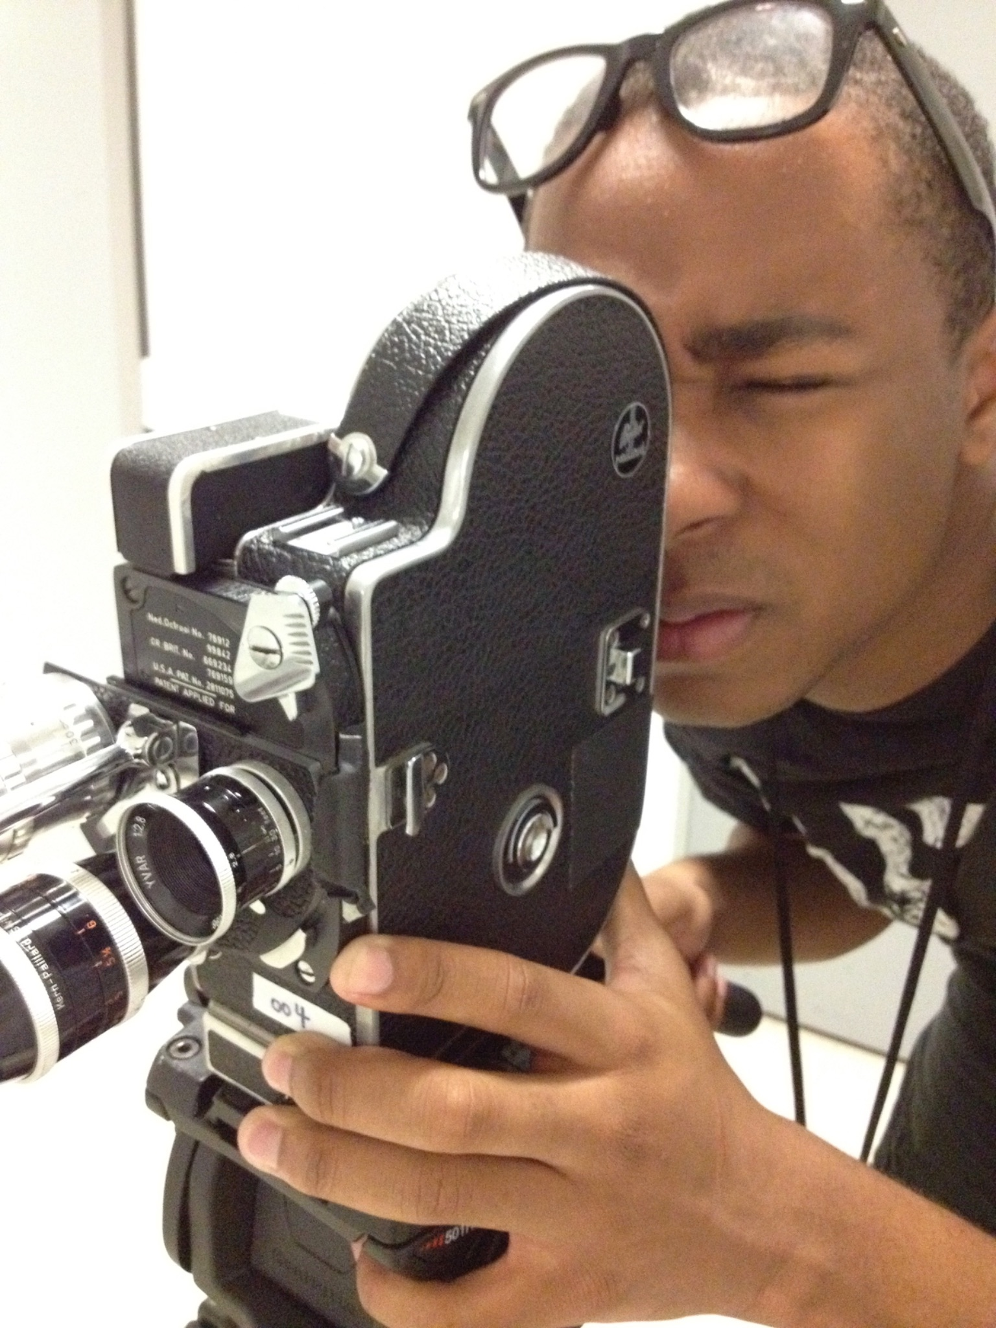
FILMMAKING
Learn how make short films using a Bolex 16mm film camera, hand-process your film, record field audio, and edit your images and sound by hand and in Adobe Premiere. This is a great class to learn the fundamentals of filmmaking, and no experience in film or video is required.
Submit 1-2 videos that you worked on and identify your role in the production (writer, director, camera, editor) or submit 6-8 photographs, drawings, or other work that reflects your artistic vision. Write about your work in your Artist Statement. (You may also include storyboards or written scripts.)
Submit all files using Google Drive or provide links to the work in your portfolio.

Slide 8
Filmmaking Application Artist Statement
Write about the work that you created independently or that you collaborated on - be sure to identify your role in the production (writer, director, camera, editor, etc) work in your Artist Statement. (250 words max.)
[Type here]

Slide 9
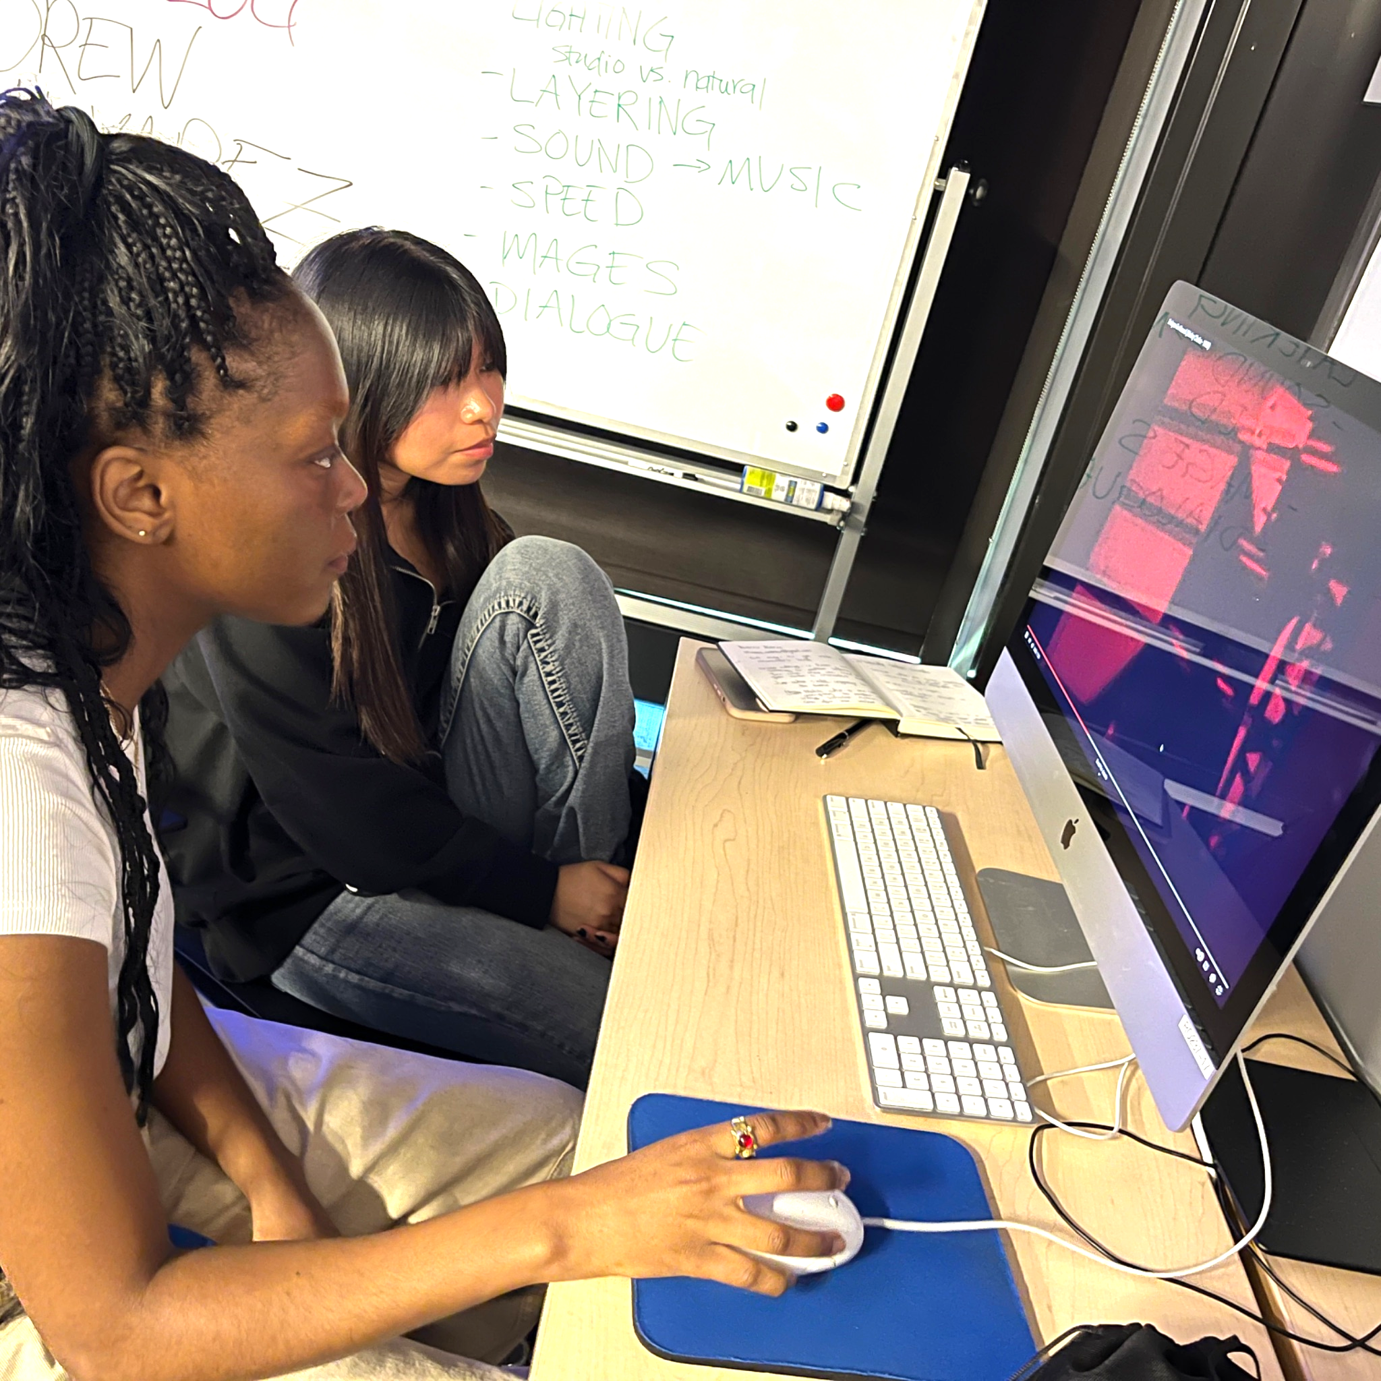
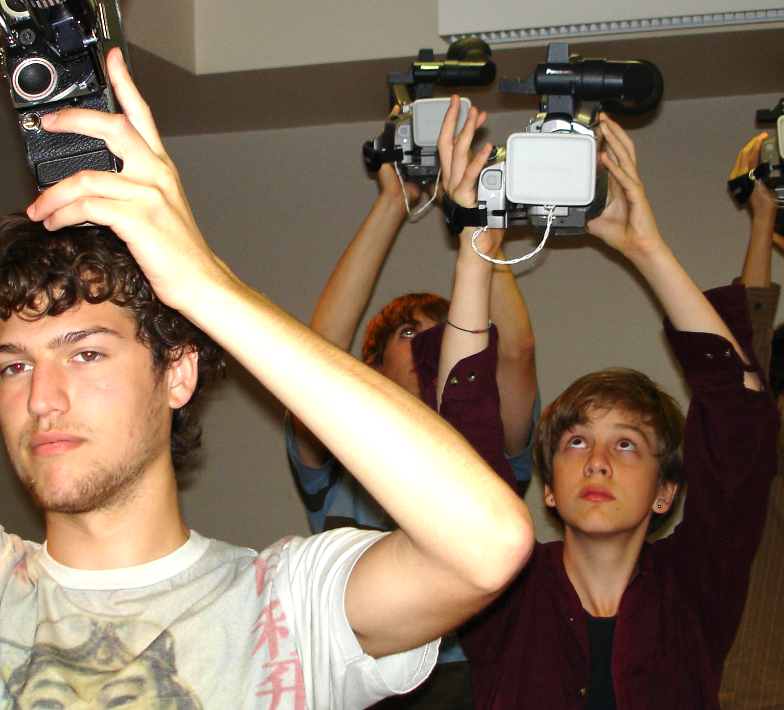
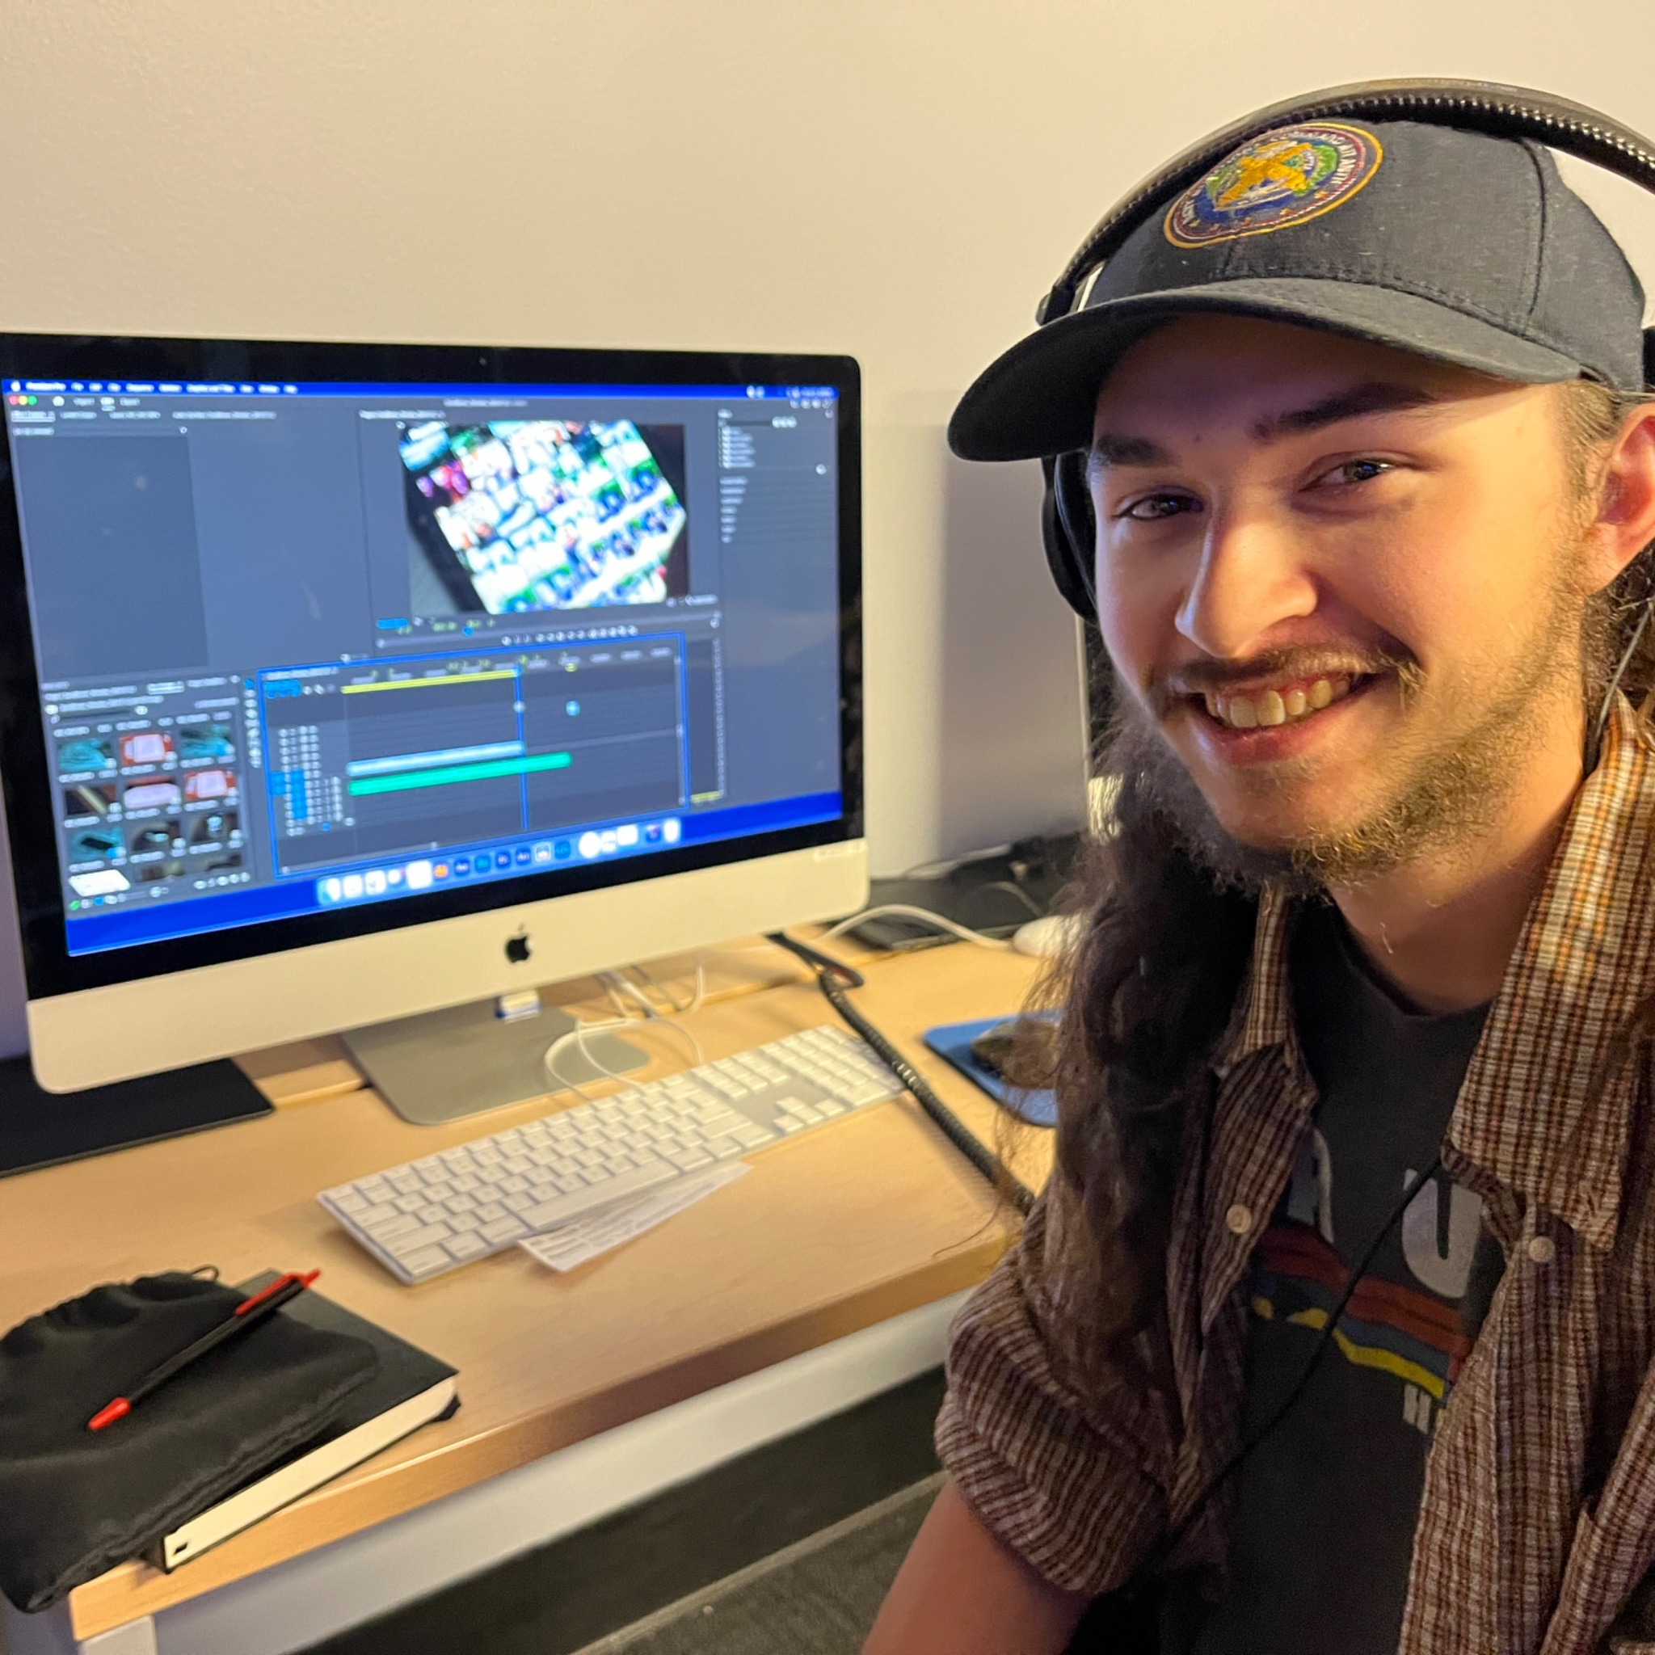
VIDEO ART
In your portfolio, submit up to 2 videos that you created via Google Drive or link (Youtube or Vimeo) and describe the work in your Artist Statement. Identify your role in the production (writer, director, camera, editor, etc) You may also include storyboards or short scripts.
If you have no prior experience in video production, explain in your artist statement why you wish to study video at NYSSSA.
This class explores video as an artistic medium that can communicate ideas through story, sound, and image. You will learn digital camera skills, studio lighting, field audio recording and digital editing tools on Adobe Suite.

Slide 10
Video Art Application Artist Statement
Write about the work that you created independently or that you collaborated on - be sure to identify your role in the production (writer, director, camera, editor, etc) work in your Artist Statement. (250 words max.)
[Type here]

Slide 11
Link#1

Slide 12
Link#2

Slide 13
Artwork #1

Slide 14
Artwork #2

Slide 15
Artwork #3

Slide 16
Artwork #4

Slide 17
Artwork #5

Slide 18
Artwork #5

Slide 19
Artwork #6

Slide 20
Artwork #7

Slide 21
Artwork #8

