Slide 1
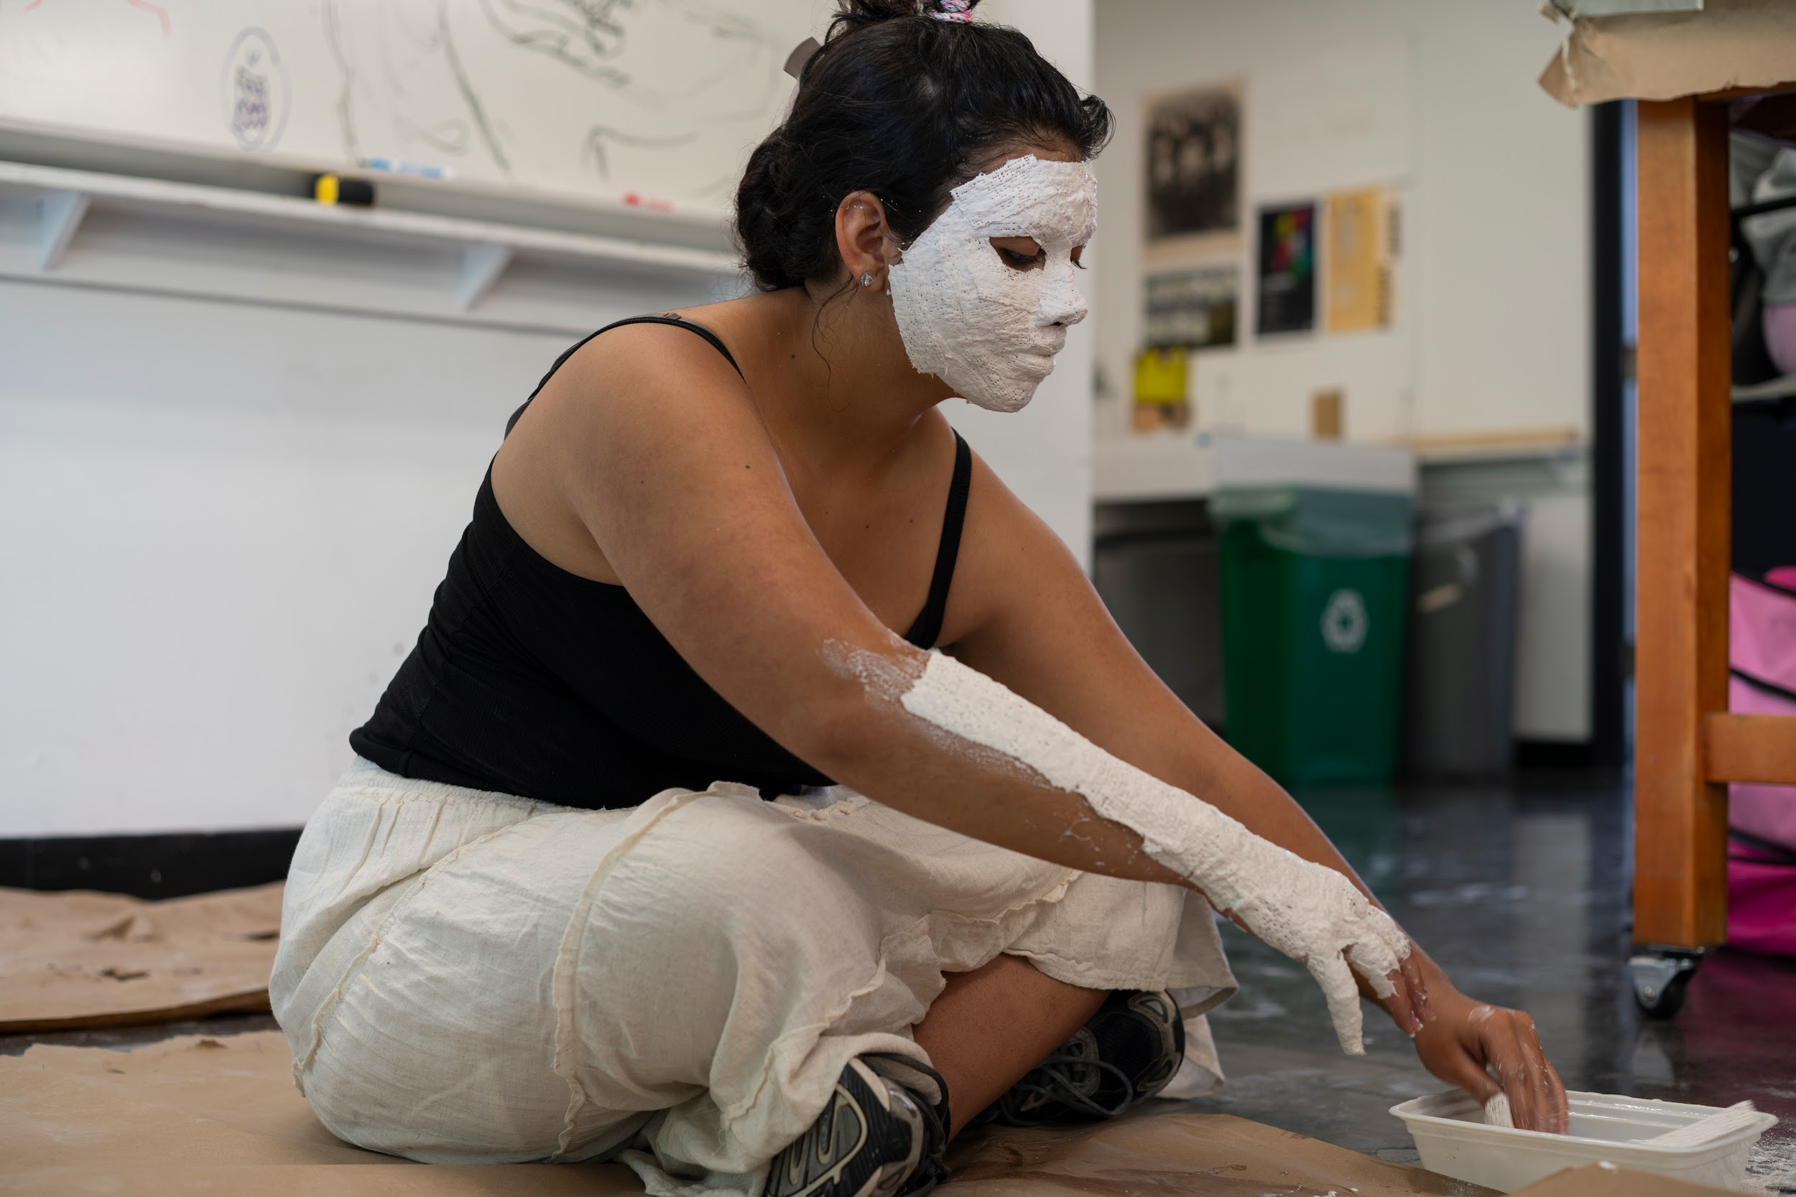

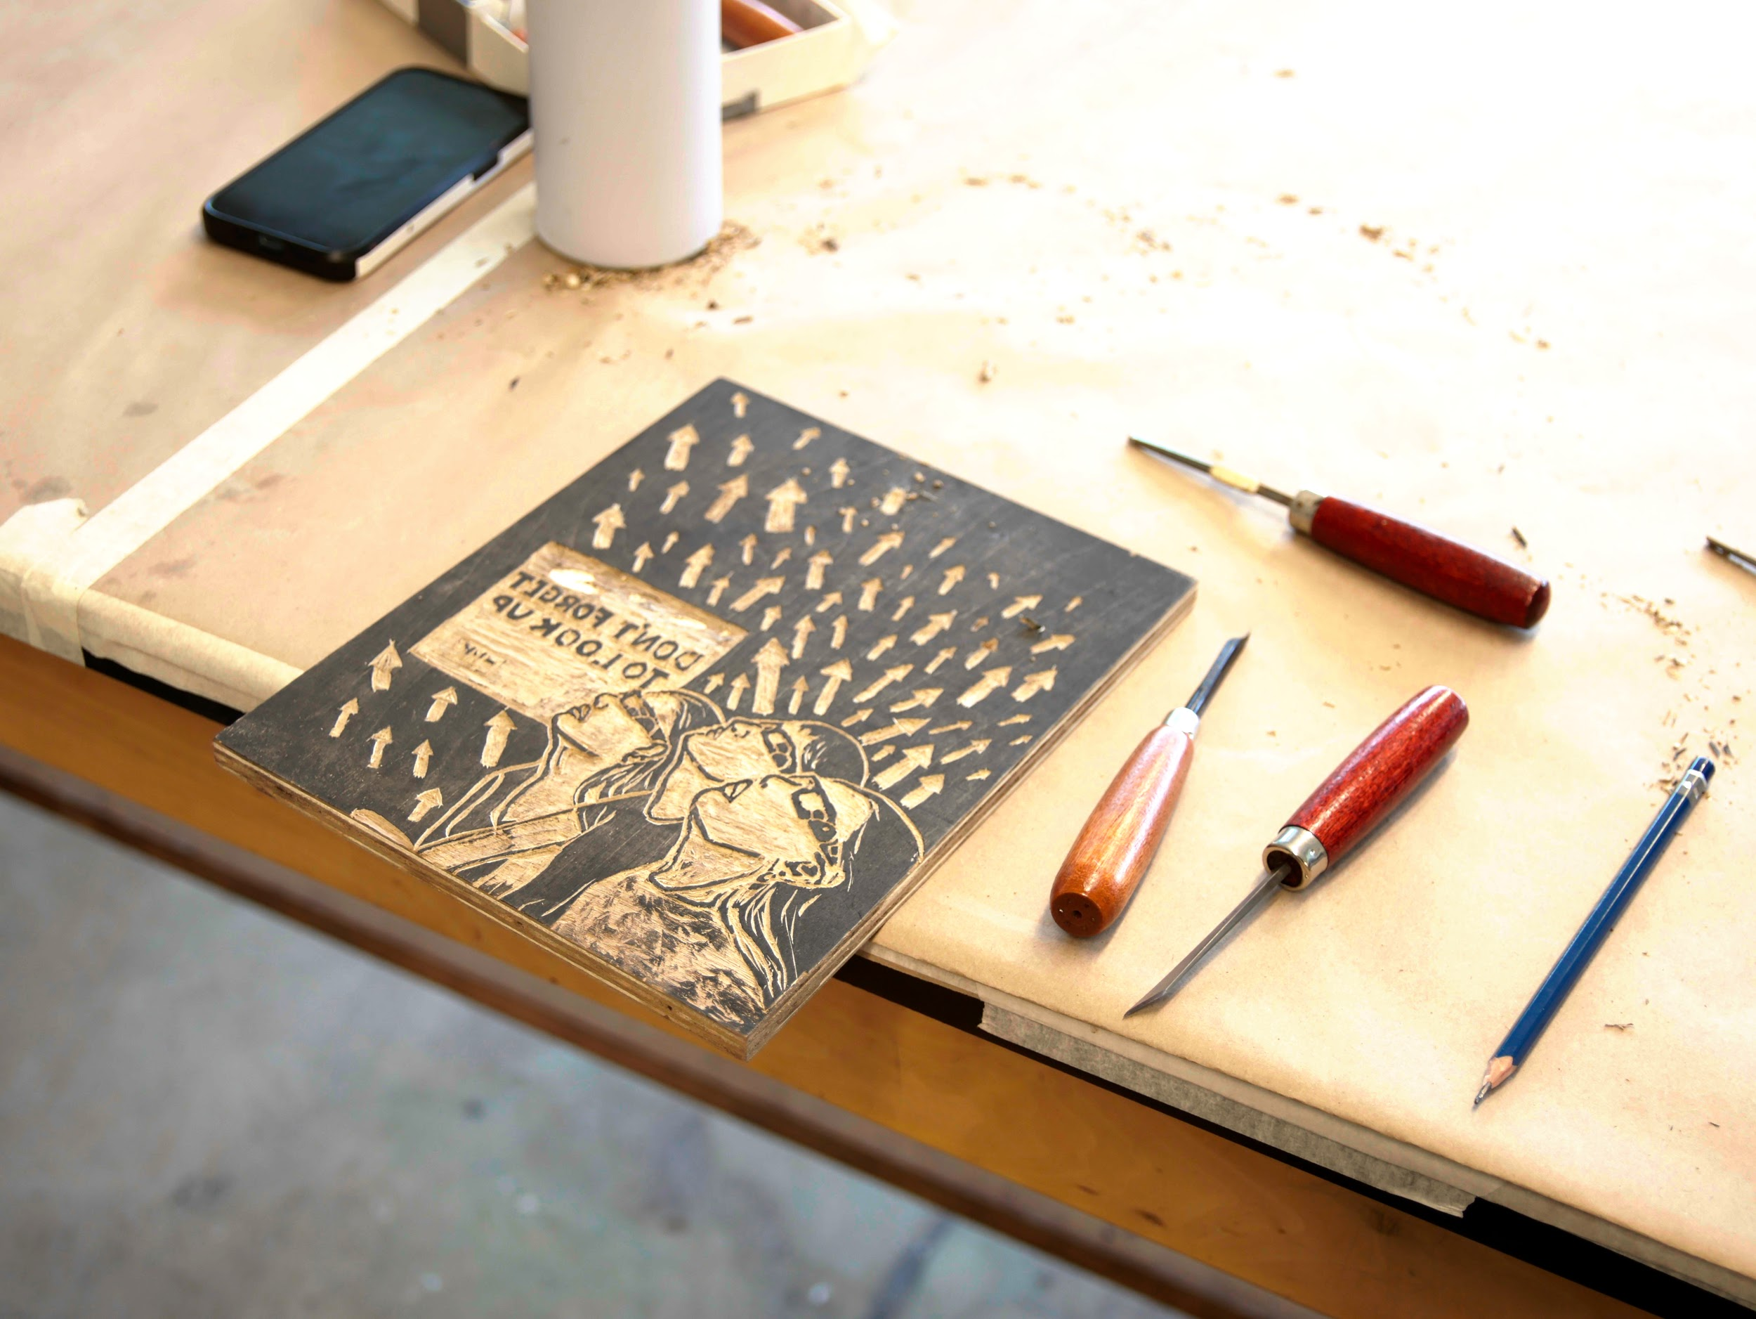
NEW YORK STATE
SUMMER SCHOOL OF THE ARTS
Portfolio Guide for 2025 VISUAL ARTS Applications

Slide 2
HOW TO MAKE YOUR VISUAL ARTS PORTFOLIO
After you’ve downloaded this presentation, open it in Google Slides (File Open Upload)
Respond to the Artist Statement prompt. Your response should fit the text box provided.
Submit 8-10 images; one image per slide.
Insert one artwork photo per slide. Make the artwork image as large as possible without touching the slide edges. Include the artwork’s title, dimensions, and medium as well.
Change the title of the presentation in the upper left corner of your screen using the format Lastname_Portfolio.
Check your sharing settings. Under general access, change to “anyone with this link can view.”
Make a Google folder titled as LastName_FirstName_SVA.
Check the sharing settings on your Google folder. Change to “anyone with this link can view.” Place your slide show into the folder.
Share with nysssa@nysed.gov

Slide 3
VISUAL ARTS PORTFOLIO NOTES
We strongly encourage students to submit work from direct observation.
We recommend that a self-portrait from direct observation (not a photograph) be included.
Two views should be included for all three-dimensional work.
We encourage students to include work from their sketchbooks.
Photographed images of work should be clear and sized/formatted properly.

Slide 4
Artist Statement
Please describe your ideas when creating your work and why you are interested in pursuing advanced studies in visual arts. (250 words max.)
[Type here]

Slide 5
Artwork #1

Slide 6
Artwork #2

Slide 7
Artwork #3

Slide 8
Artwork #4

Slide 9
Artwork #5

Slide 10
Artwork #6

Slide 11
Artwork #7

Slide 12
Artwork #8

Slide 13
Artwork #9

Slide 14
Artwork #10

